Slide 1
Greedy Algorithms, Activity Selection, cont’d
CLRS Chapter 16.1, 16.2

Slide 2
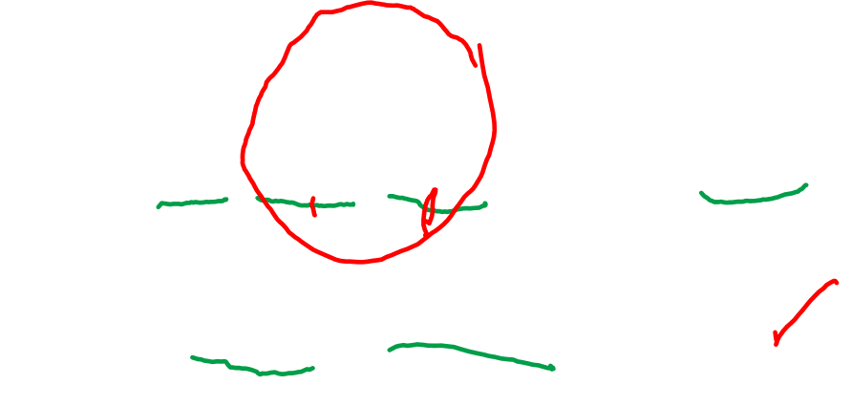
Problem Parameters
We are given a set of n proposed activities:
7 8 9 10 11 12 13 14 15 16 17 18 19 20 21
S={a₁,a₂,…,a_{n}}.
Each a_{i} has a start time s_{i} and finish time f_{i}
s₁=9 f₁=13 s₂=14 s₃=15 f₂=16 f₃=19
a_{i} and a_{j} are compatible iff: f_{i} ≤ s_{j} or f_{j} ≤ s_{i}. Why?

Slide 3
Optimal Substructure
Think of the problem in steps:
Which activity would I schedule first, based on immediate information?
After that activity is scheduled, I have less time over which to schedule my activities, thus a smaller subproblem.
If I make my first “greedy” choice correctly, and solve the rest of the problem optimally, I will get optimal solution.
Intuition about first choice: leave as much free time as possible.

Slide 4

Greedy Algorithm Ideas for Activity Selection
Pick activity with earliest start time first:
Pick shortest activity first:
Optimal Solution:

Slide 5

A Solution that Works:
Pick activity with earliest finish time, then the next, etc
Make sure there are no overlaps
Have to sort activities by finish time at the beginning
If purple is in the optimal solution, if we can solve the rest optimally, we will have found an optimal solution!

